Slide 1
Gravitational Field
Gravitational field strength.
Satellite motion.
Impact of satellite on everyday life.

Slide 2
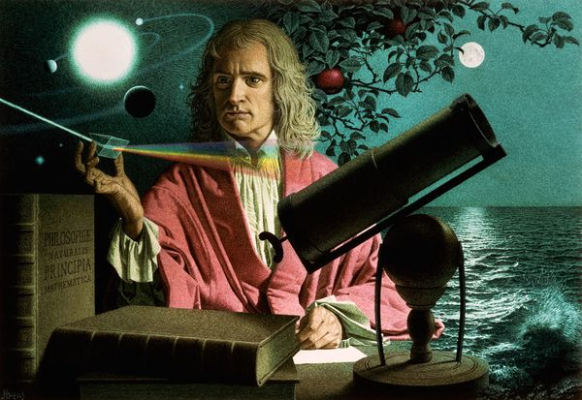
Gravitational Field
Why does moon/satelite/planet move in a circular orbit around earth?
gravitation was a
force of attraction
that acted between
any bodies

Slide 3
Gravitational Field
The gravitational force acting between two bodies, m and M:
(a) is one of attraction, and can be
considered to act from the centre
of each mass
F_{g}
F_{g}
M
m

Slide 4
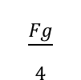
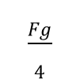
Gravitational Field
The gravitational force acting between two bodies, m and M:
(b) acts equally and oppositely on
each mass.
(Newton’s third law): F1 = −F2
$$\frac{Fg}{4}$$
$$\frac{Fg}{4}$$
M
m

Slide 5
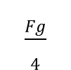
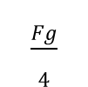
Gravitational Field
The gravitational force acting between two bodies, m and M:
(c) is weaker if the masses are further
apart
$$\frac{Fg}{4}$$
$$\frac{Fg}{4}$$
m
M
2r

Slide 6
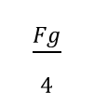

Gravitational Field
The gravitational force acting between two bodies, m and M:
(c) is weaker if the masses are further
apart
$$\frac{Fg}{4}$$
$$\frac{Fg}{4}$$
m
$$Fα\frac{1}{r^{2}}$$
M
r

Slide 7
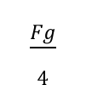
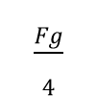
Gravitational Field
The gravitational force acting between two bodies, m and M:
(d) depends directly on the mass of each
body involved,
$$\frac{Fg}{4}$$
$$\frac{Fg}{4}$$
m
M

Slide 8
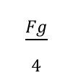
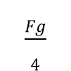

Gravitational Field
The gravitational force acting between two bodies, m and M:
(c) depends directly on the mass of each
body involved,
$$\frac{Fg}{4}$$
$$\frac{Fg}{4}$$
m
M
$$F α m$$

Slide 9

Gravitational Field
NEWTON’S LAW OF UNIVERSAL GRAVITATION
$Fg=\frac{GMm}{r^{2}}$
Fg = Gravitational Force (N)
M and m = masses of the body attracted (kg)
r = distance between center of the bodies (m)
G = Gravitational constant ( 6.67 x 10⁻¹¹ Nm²kg⁻²)

Slide 10
Gravitational Field
Example 1
What is the gravitational force between
two objects, each of mass 40 kg, when
they are 6 m apart? [2.96 × 10⁻⁹ N]

Slide 11
Gravitational Field
Example 2
A 10.0 kg watermelon falls a short distance to the ground. If the Earth has a radius of 6.4 ×10⁶ m (6400 km) and a mass of 6.0 × 10²⁴ kg, calculate:
a. The gravitational force that the Earth exerts on
the watermelon [97.7 N]
b. The gravitational force that the watermelon exerts
on the Earth [97.7 N]
c. The acceleration of the watermelon towards the Earth
[9.77 ms⁻²]
d. The acceleration of the Earth towards the watermelon.
[1.63 × 10⁻²³ ms⁻²]

Slide 12
Gravitational Field
Example 3
The gravitational force that acts on a 1200 kg
space probe on the surface of Mars is 4430 N. The radius of Mars is 3400 km. Without using the mass of Mars, determine the gravitational force that acts on the space probe when it is:
3400 km above the surface of Mars
[1.11 × 10³ N]
6800 km above the surface of Mars.
[492 N]

Slide 13
Gravitational Field
Example 4
Predict the effect on the gravitational force between two objects of:
Doubling the distance between them.
[1⁄4 of the original value]
Doubling both masses.
[4 times the original value]
Halving one mass and the distance between them [twice the original value]

Slide 14
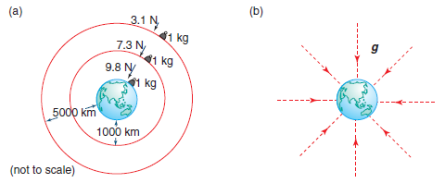
Gravitational Field
Factors that effect gravitational field
(a)Altitude
Higher the altitude , lower the
gravitational field
This is due to the separation of the radial
field line that gets larger as move away from
the earth

Slide 15
Gravitational Field
Factors that effect gravitational field
(b) stronger at the poles compared to
equator.
Due to diameter of equator is bigger
compared to poles
(c) density of an area

Slide 16
Gravitational Field
Example
The field diagrams represent the relative strengths of the gravitational fields of two planets X and Y. The planets have the same radius.
Which statement about these two planets is correct?
The acceleration due to gravity at the surface of each planet is the same
The mass of planet X must be greater than the mass of planet Y.
The gravitational force acting on an object above the surface of X will be less than the gravitational force acting on the same object the same distance above the surface of Y.

Slide 17

Gravitational Field
Calculating gravitational field strength
$g=\frac{Fg}{m}=\frac{GMm}{mR^{2}}$ = $\frac{GM}{R^{2}}$

Slide 18
Gravitational Field
Example 5
Calculate the gravitational field strength g:
a. At the surface of the Earth (mass of Earth is 6.0
× 10²⁴ kg, radius of Earth is 6.4 × 10⁶ m)
[9.77 Nkg⁻¹]
b. At the surface of the Moon (mass of Moon is
7.3 ×10²² kg, radius of Moon is 1.7 × 10⁶ m)
[1.68 Nkg⁻¹]
c. Determine the weight of an astronaut, whose total
mass is 100 kg, at each of these locations.
[977 N, 168 N]

Slide 19
Gravitational Fields
Example 6
A 50 kg piece of space junk is falling towards Earth from a height of 1000 km above the Earth’s surface (mass of Earth is 6.0 × 10²⁴ kg , radius of Earth is 6.4 × 10⁶ m). Ignoring air resistance, determine:
a) The gravitational field strength at this height
[7.31 Nkg⁻¹]
b) The acceleration of the space junk at this height
as it falls [7.31 ms⁻²]
c) The acceleration, at an altitude of 500 km, as the
space junk continues falling towards Earth.
[8.41 ms⁻²]

Slide 20
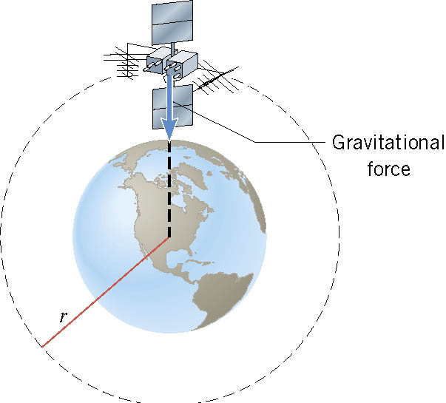
Satellite Motion
There is only one speed that a satellite can have if the satellite is to remain in an orbit with a fixed radius.

